Slide 1
Deformable Object Simulation
JunAng Wang

Slide 2
Outline
Laws of physics
Integration in time
Integration in space
How PyElastica works

Slide 3
Goal of a simulation:
Predicting the status of the moving matters at the given time

Slide 4
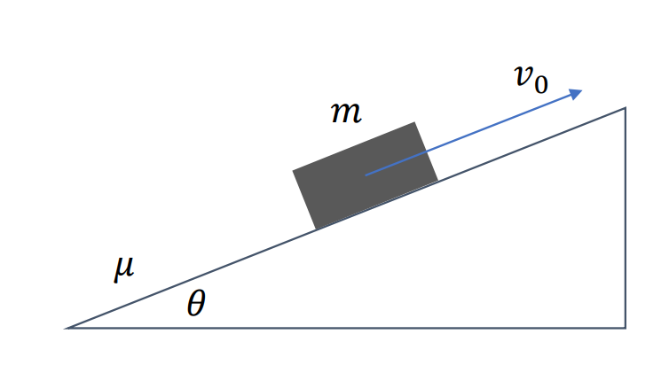
Goal of a simulation:
Predicting the status of the moving matters at the given time
Where is the block at time t=1?
What is the velocity?

Slide 5
Laws of Physics

Slide 6
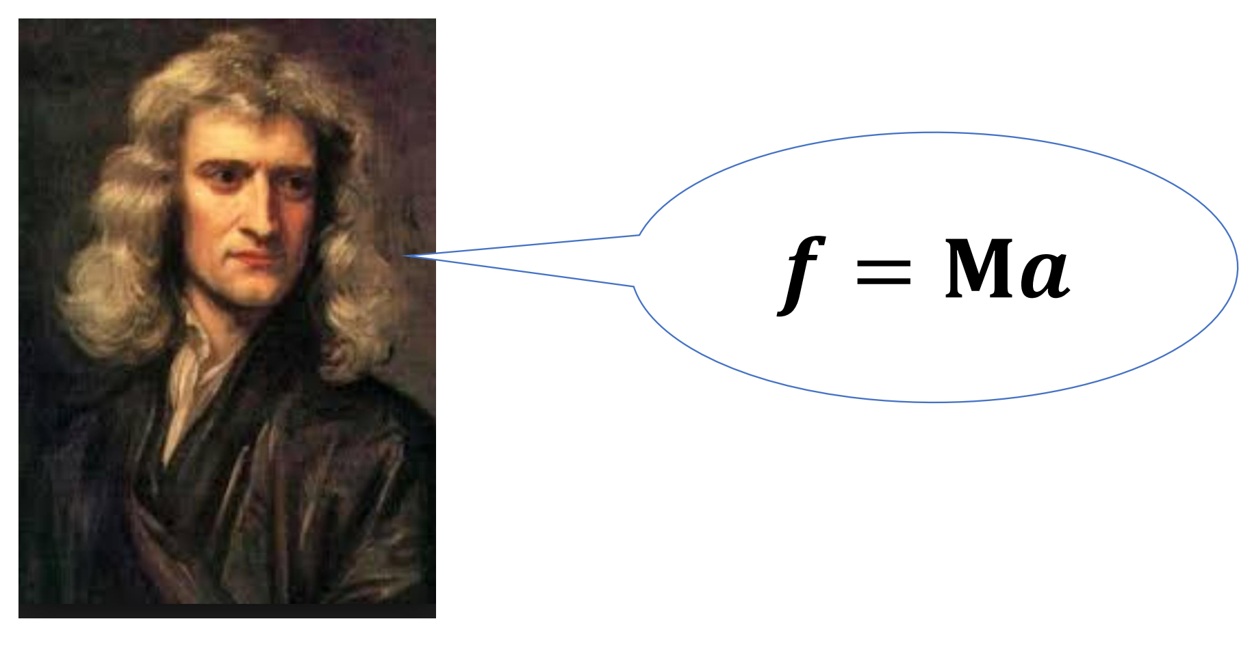
Laws of Physics

Slide 7
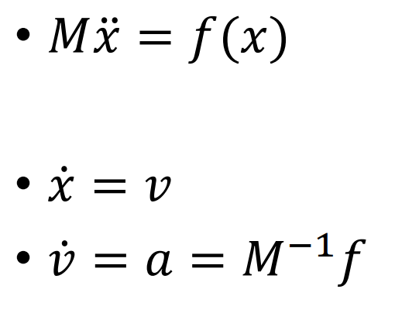
Equation of Motion

Slide 8
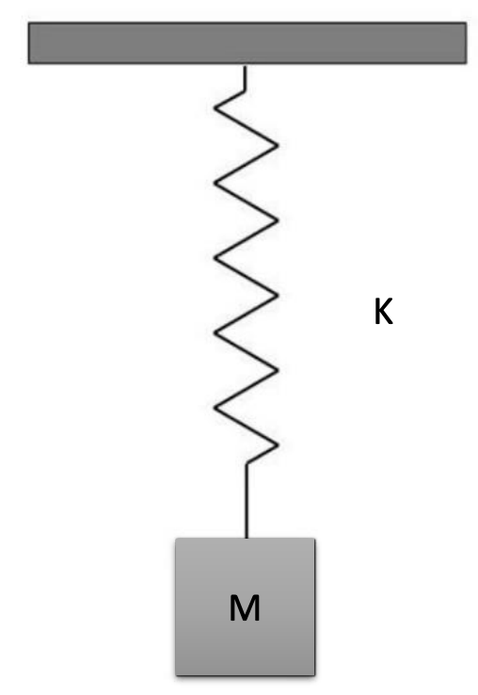
Equation of Motion

Slide 9
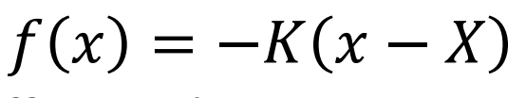
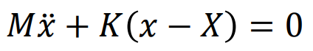
Equation of Motion
The question has a analytical solution!

Slide 10
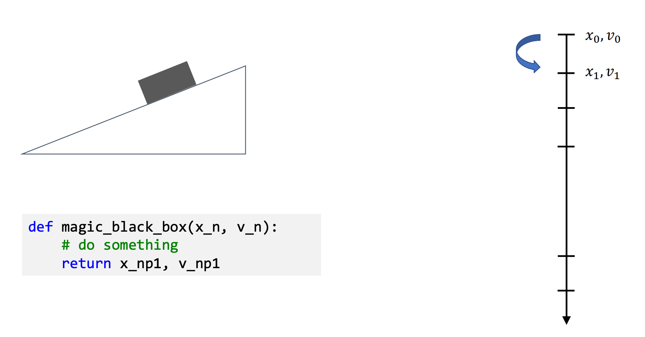
The Temporal Integration

Slide 11
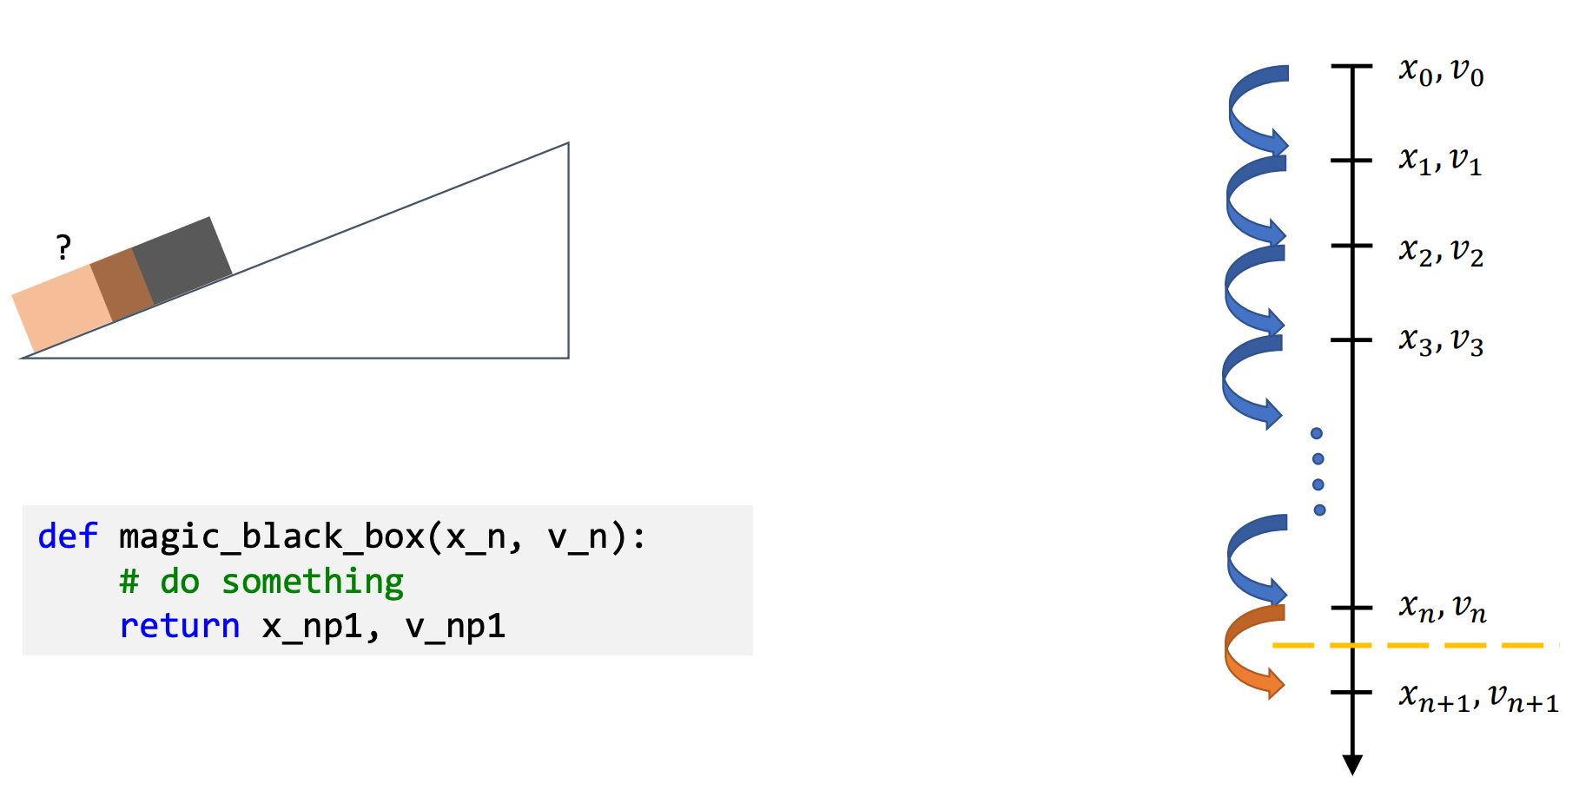
The Temporal Integration

Slide 12
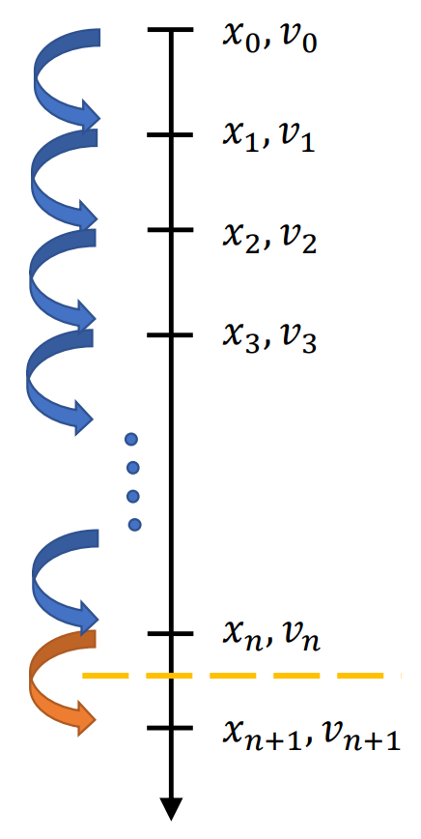
Equation of Motion

Slide 13
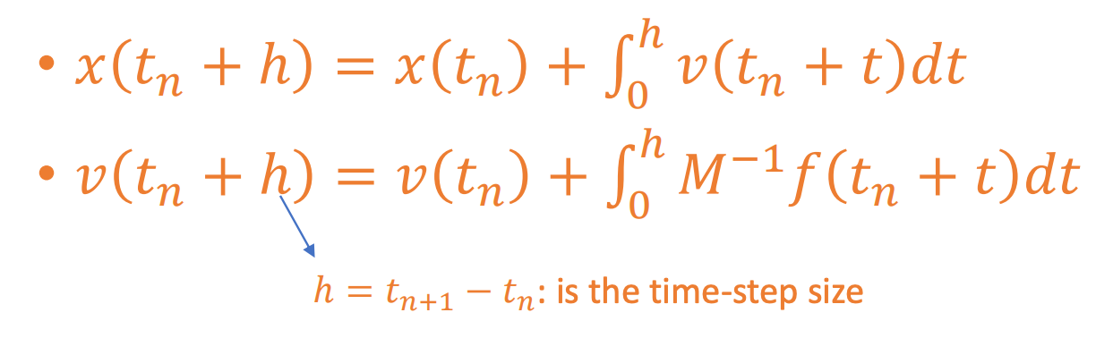
Equation of Motion

Slide 14
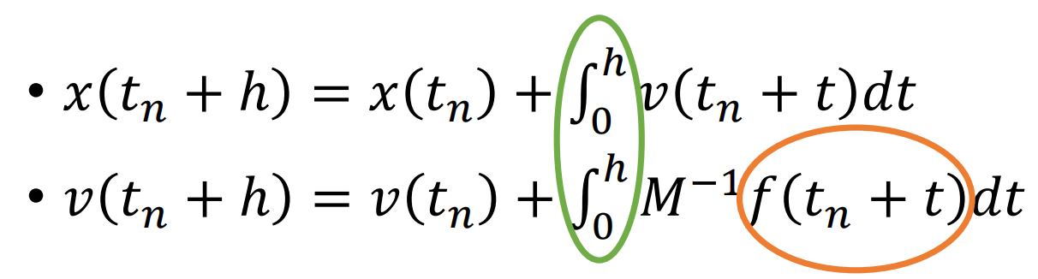
Time Integration

Slide 15
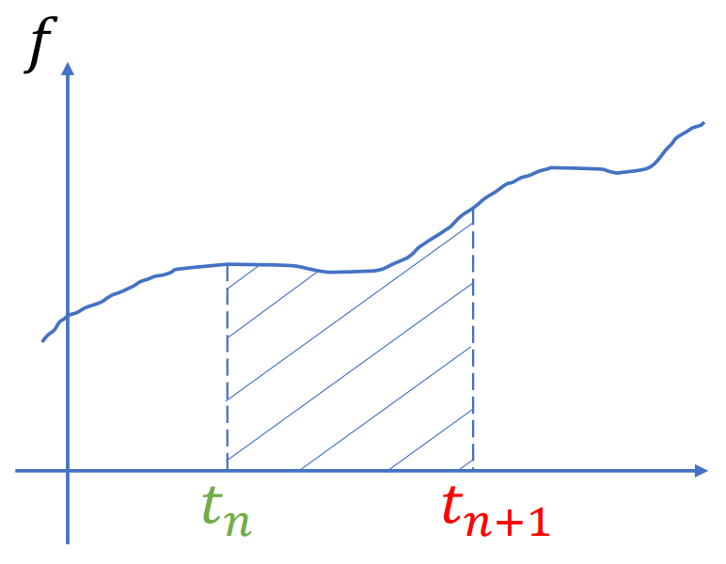
Time Integration

Slide 16
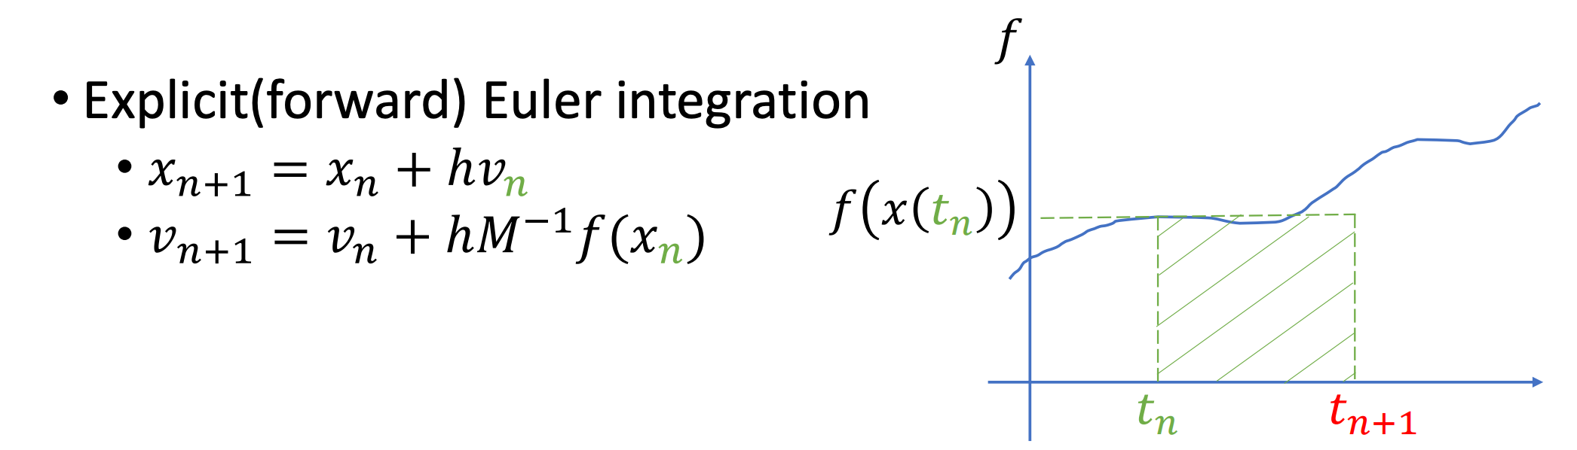
Time Integration(explicit)

Slide 17
Time Integration(explicit)

Slide 18
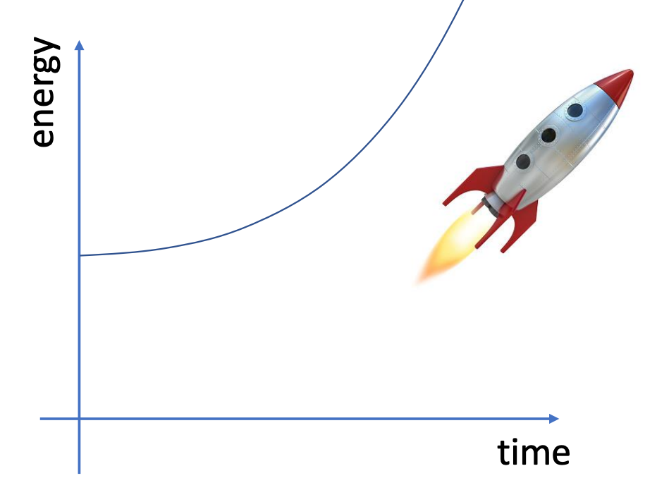
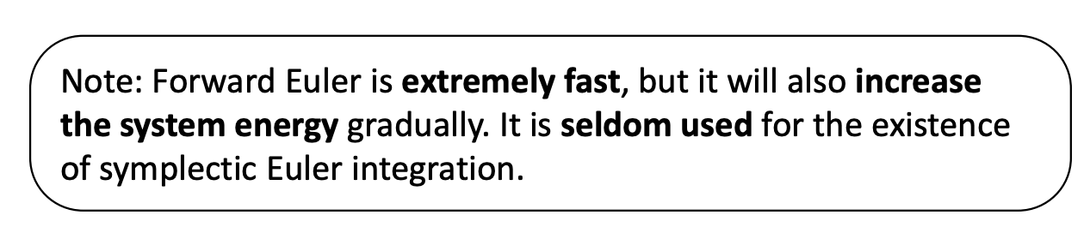
Time Integration(explicit)

Slide 19
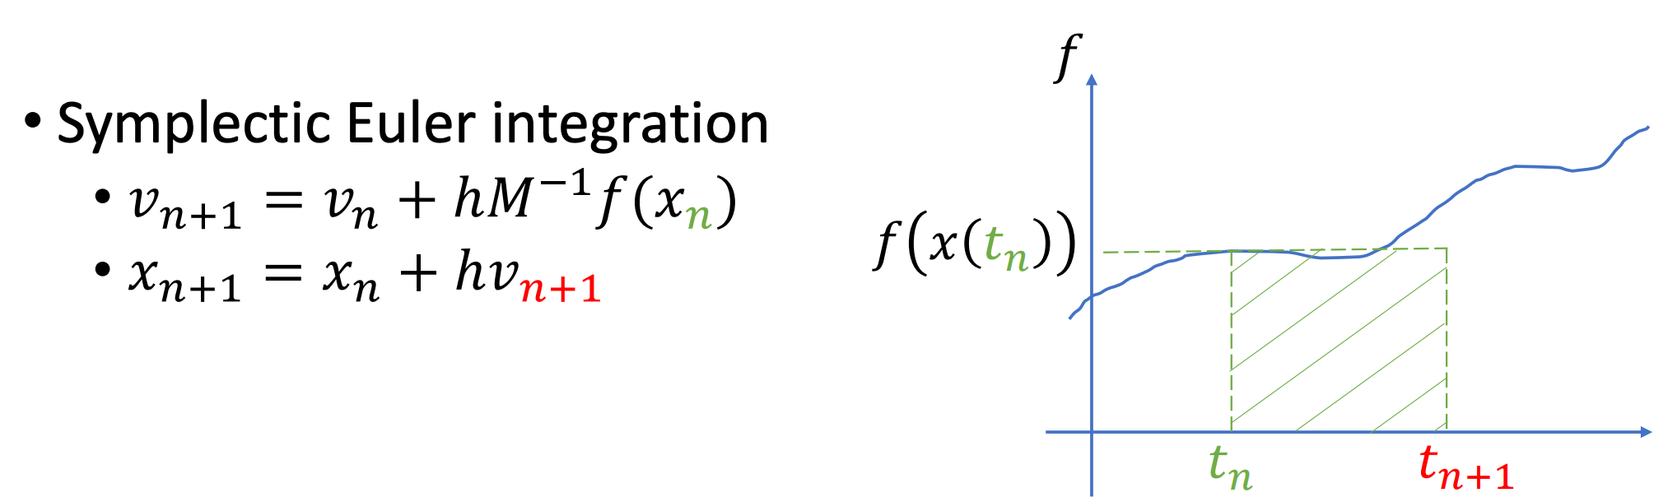
Time Integration(explicit)

Slide 20
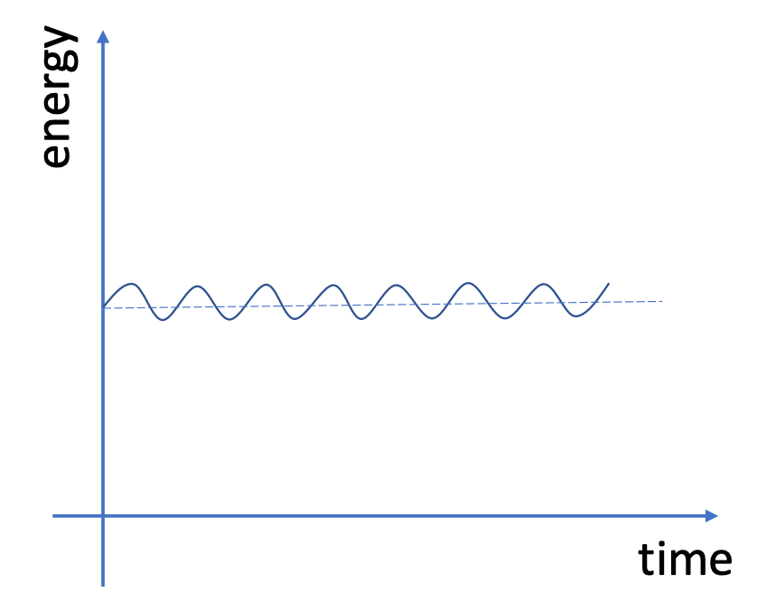
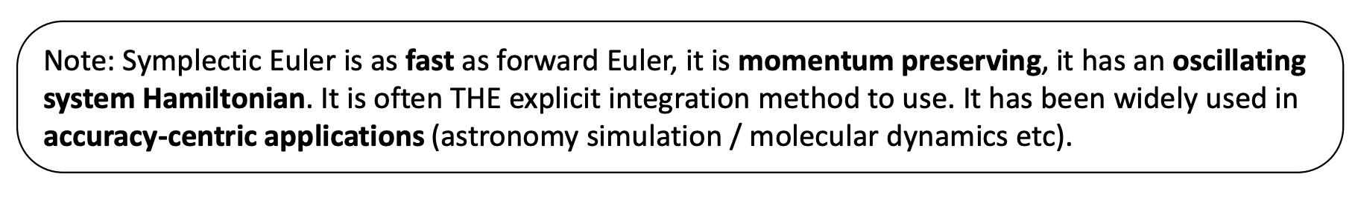
Time Integration(explicit)
Further Reading: The geometric integrator

Slide 21
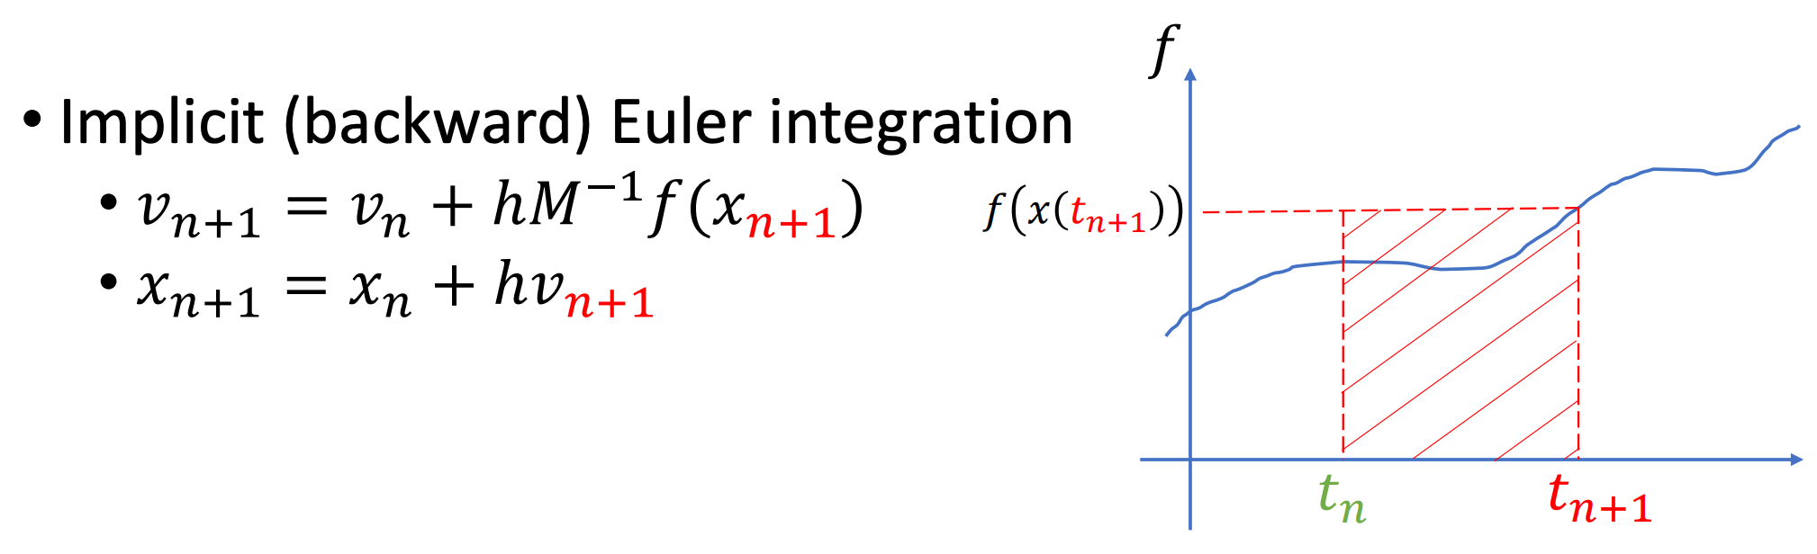
Time Integration(implicit)

Slide 22
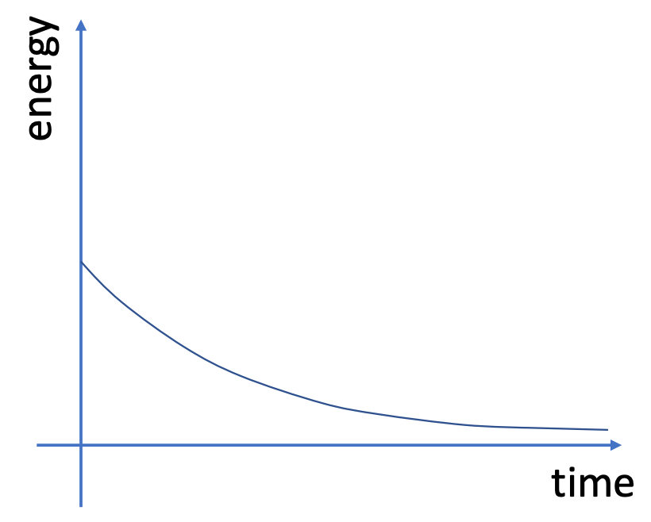
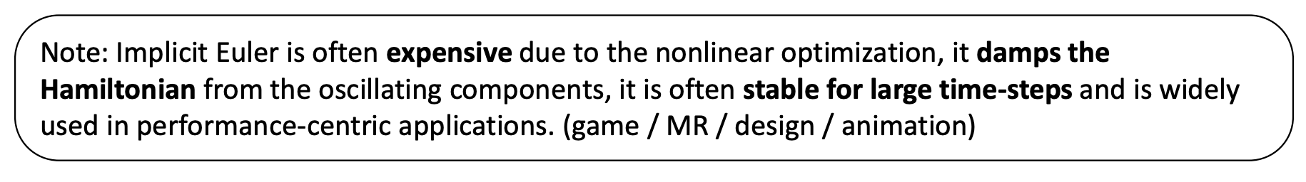
Time Integration(implicit)

Slide 23
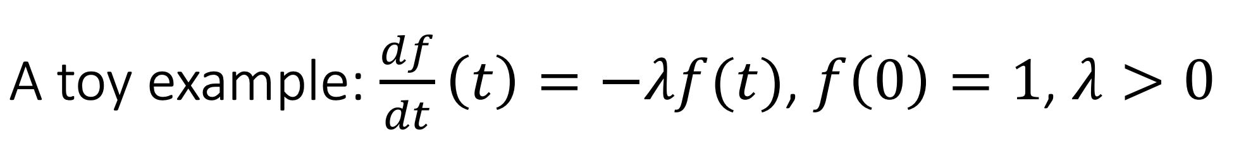
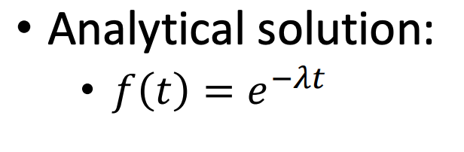

Slide 24
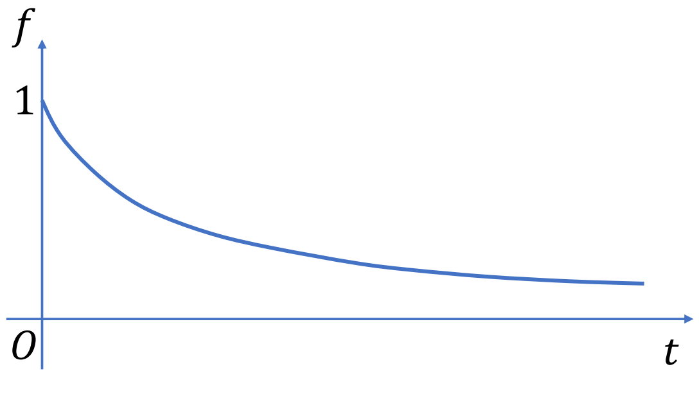

Slide 25
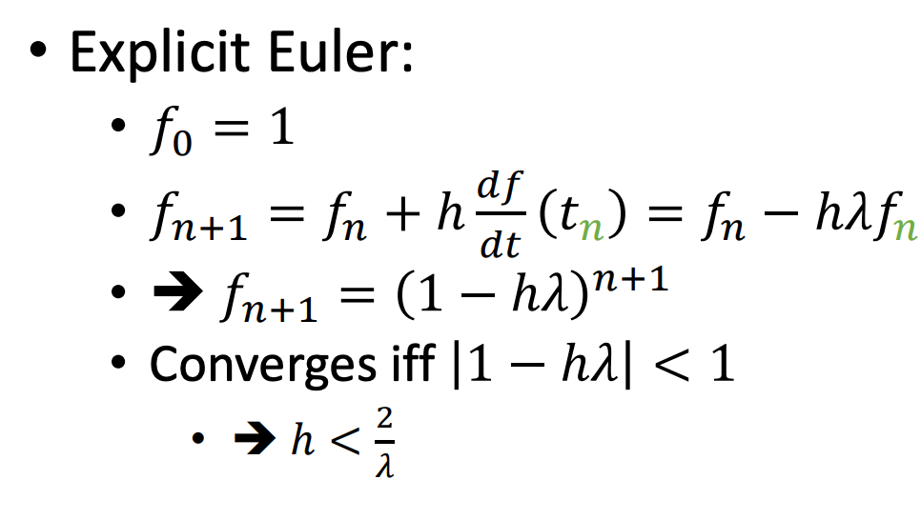

Slide 26
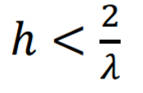
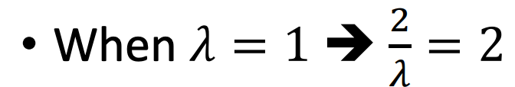

Slide 27
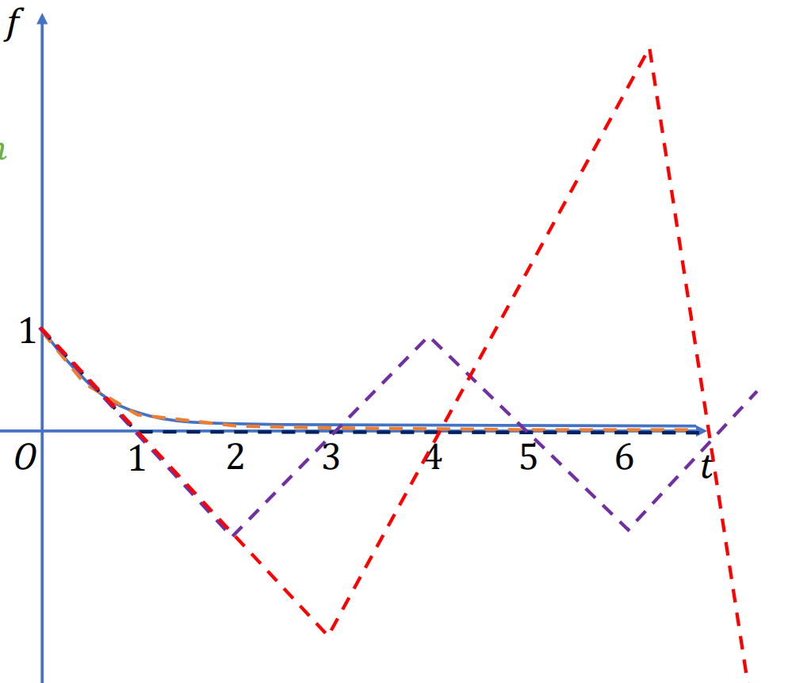
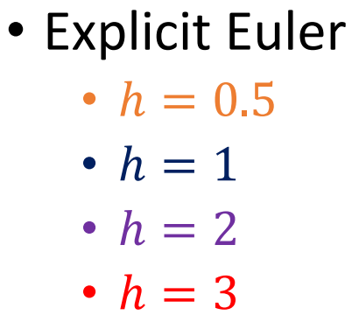

Slide 28
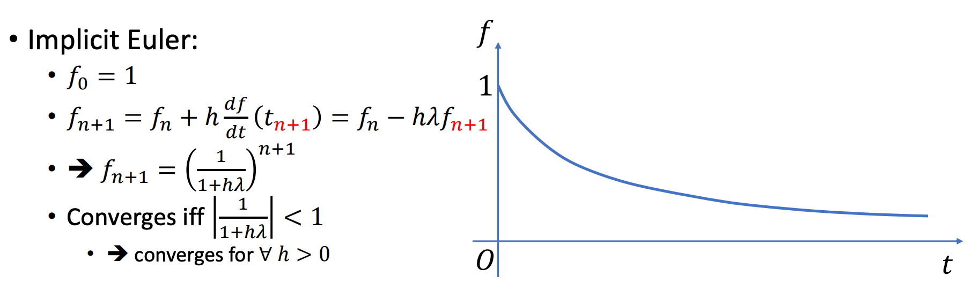

Slide 29
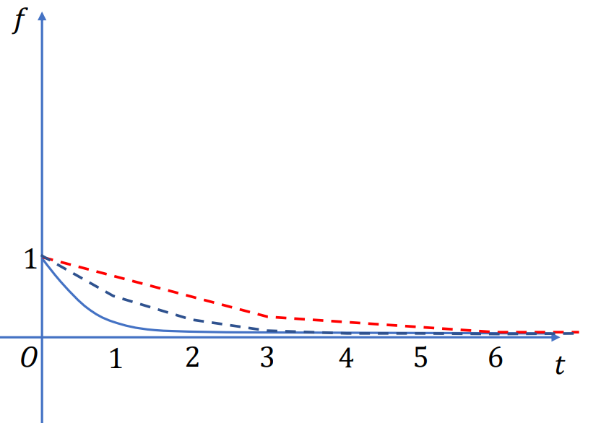
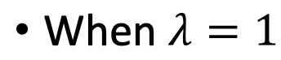
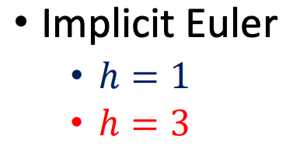

Slide 30
Time Integration in Practice

Slide 31
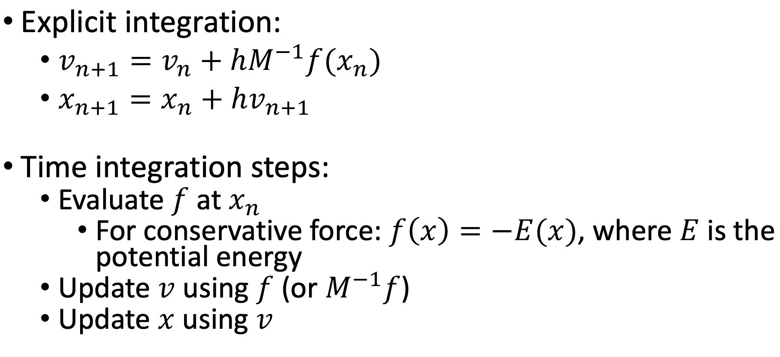
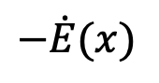
Time Integration in Practice
$$−\dot{E}(x)$$

Slide 32

Time Integration in Practice
$$−\dot{E}(x)$$

Slide 33
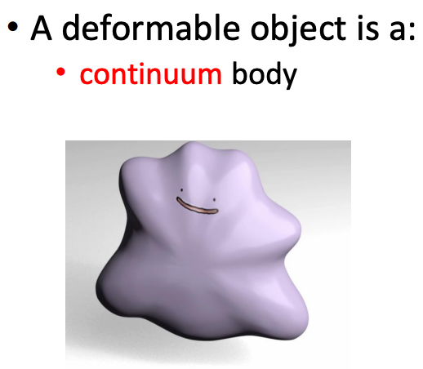
The Spatial Integration

Slide 34
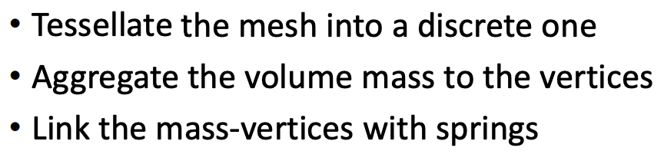
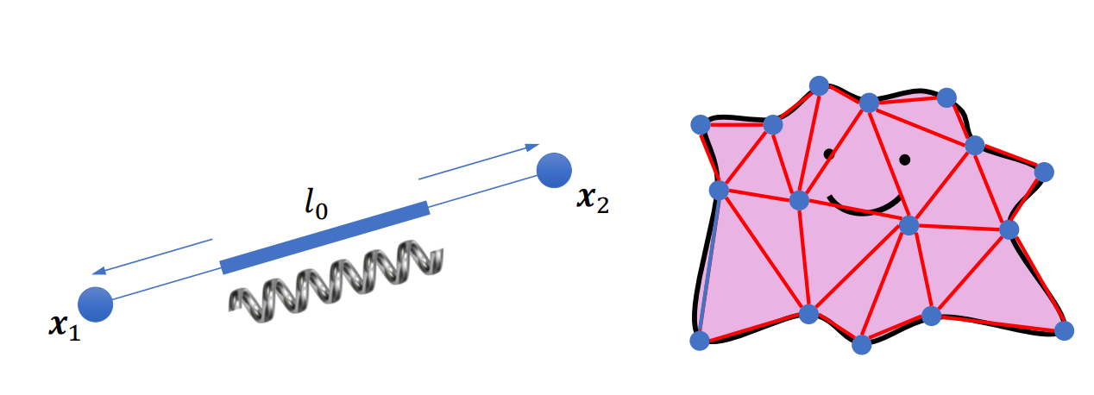
Mass-spring system

Slide 35
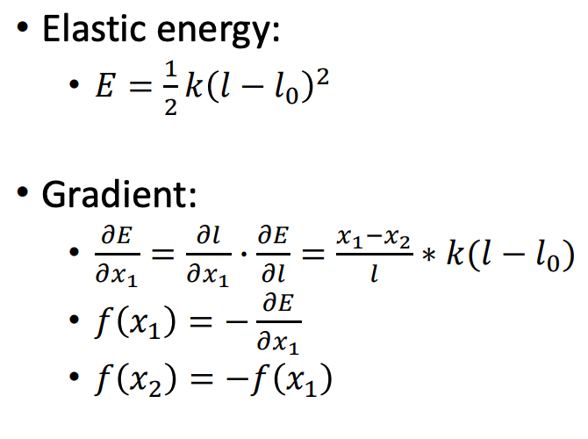
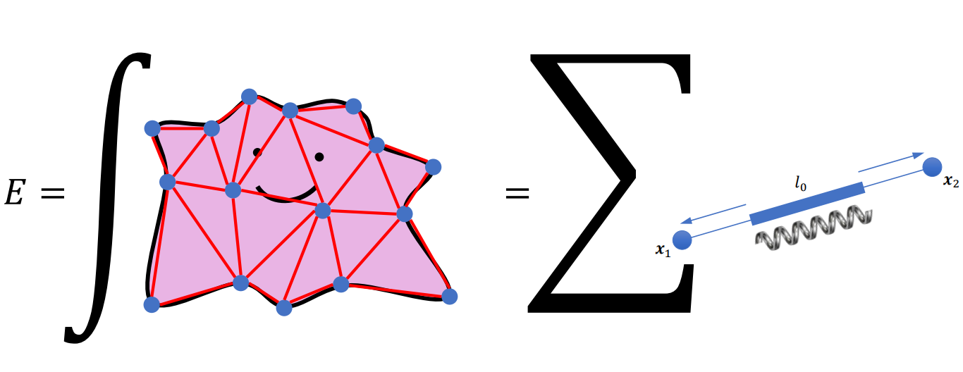
Mass-spring system

Slide 36
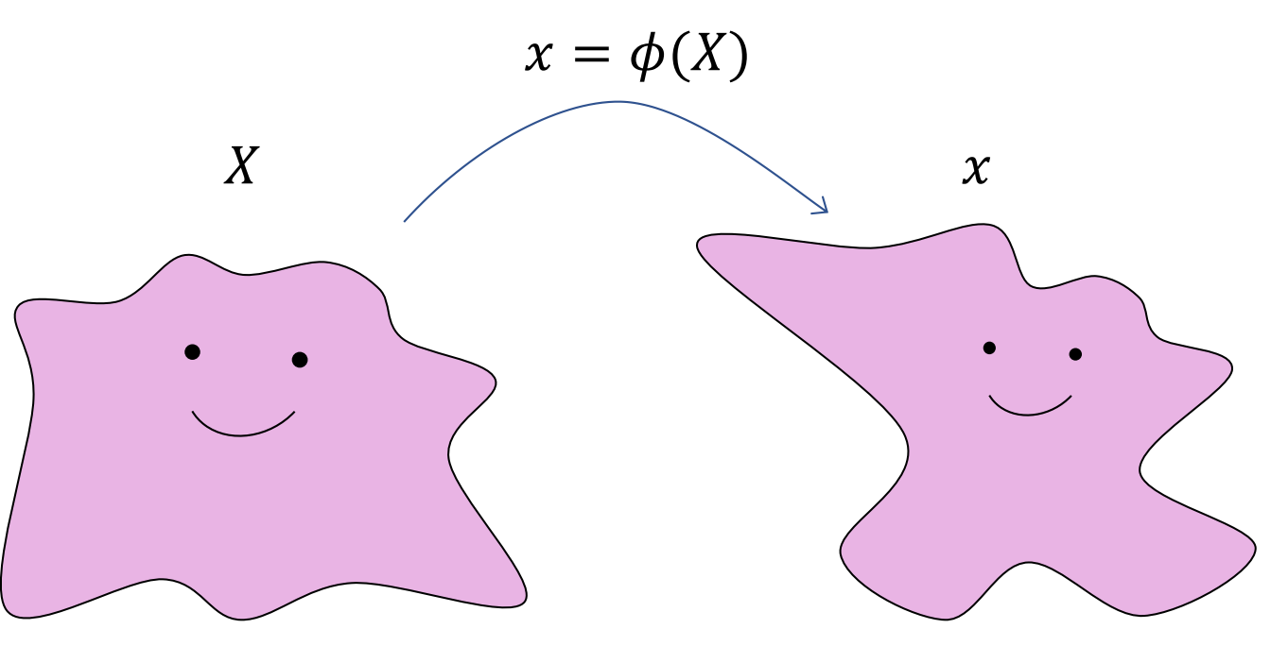
A continuous model to describe deformation

Slide 37
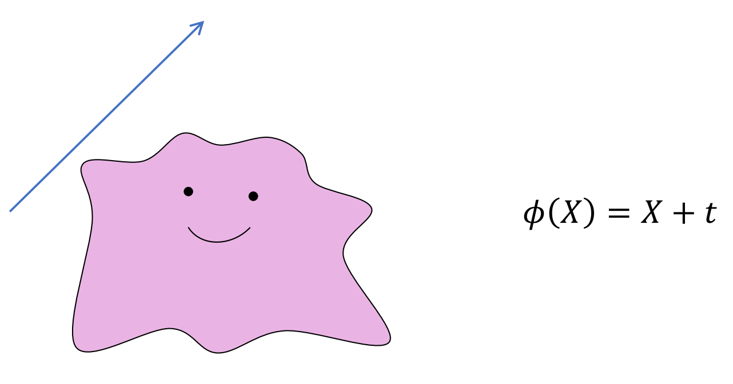
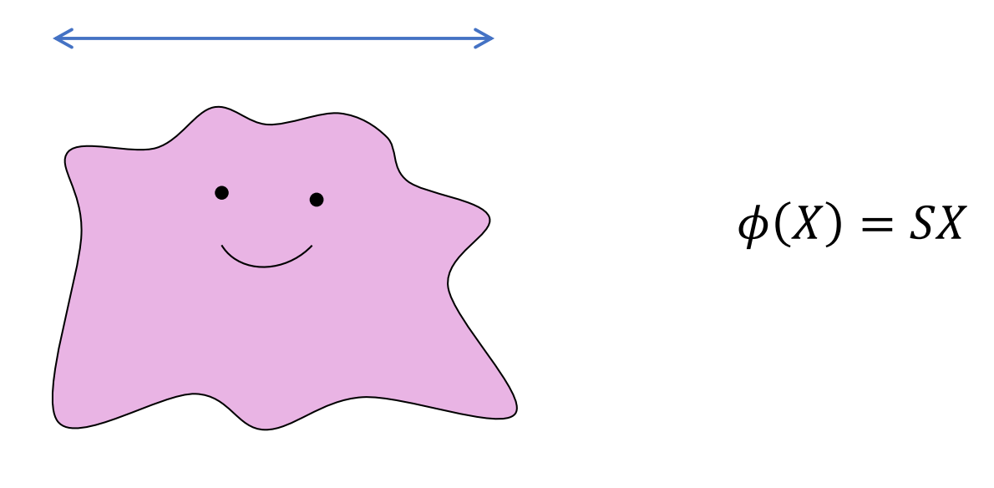
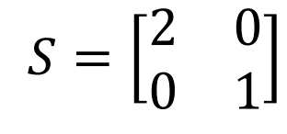
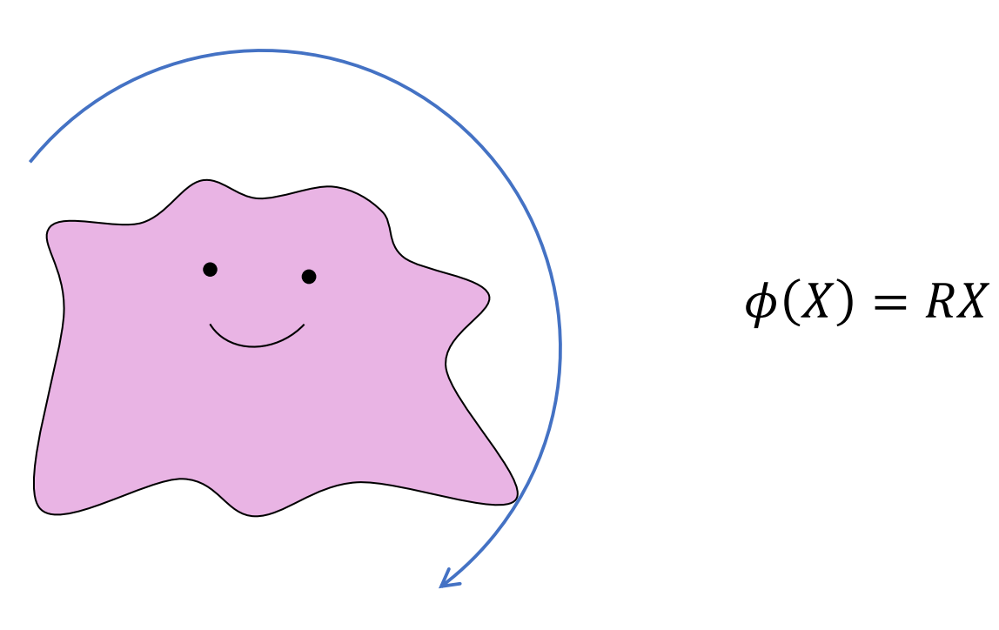
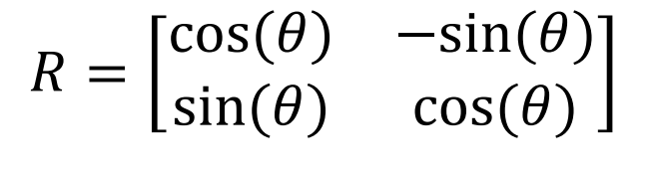
Deformation map

Slide 38
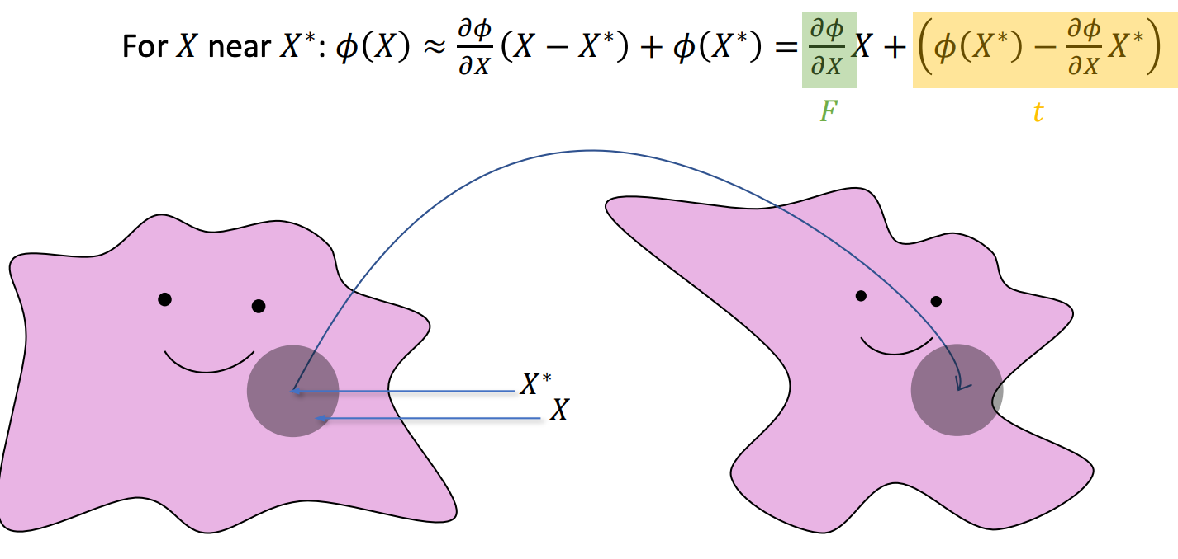
Finite Element Method

Slide 39
Finite Element Method
Deformation gradient

Slide 40
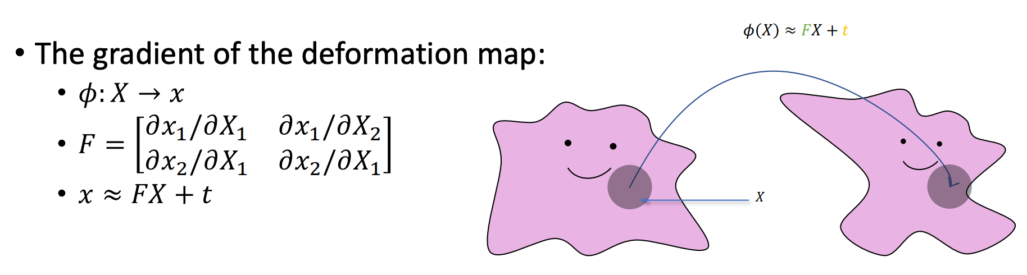
Deformation gradient

Slide 41

Deformation gradient

Slide 42
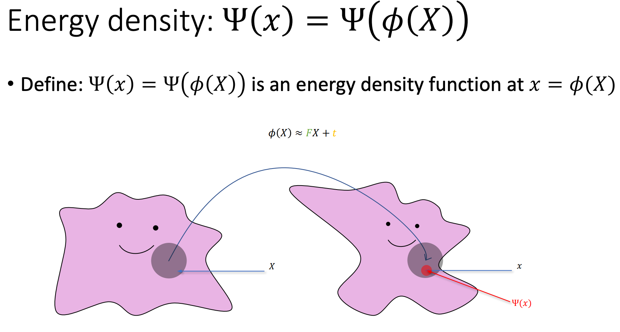

Slide 43
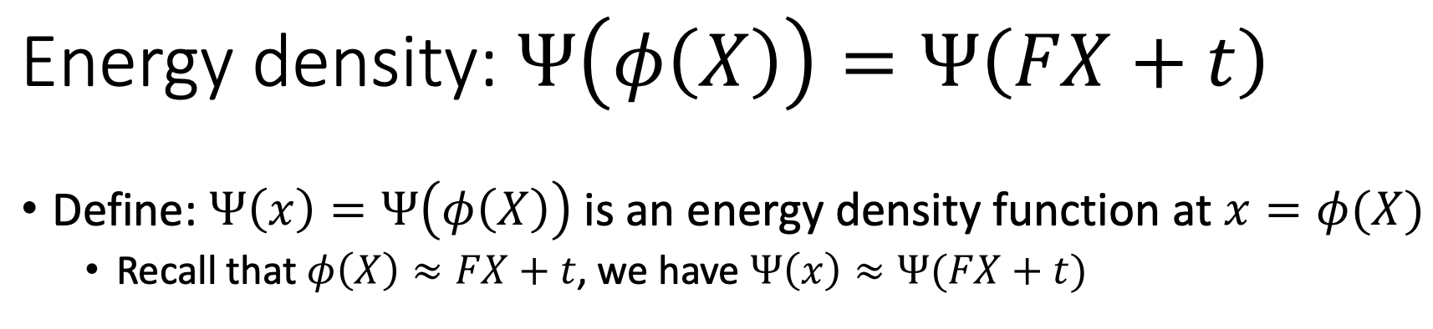

Slide 44


Slide 45


Slide 46


Slide 47


Slide 48


Slide 49


Slide 50


Laws of Physics

Slide 51
Remark
Laws of physics
Integration in time
Integration in space
How PyElastica works

Slide 52
Reference
TaiChi图形课

